Slide 1
Room

Slide 3
Save data in a local database
Save data in a local data base using Room – Room provides an abstraction layer over SQLite to allow fluent database access while harnessing the full power of SQLite
Apps handling non-trivial amounts of structured data can benefit greatly from persisting that data locally
Most common case is caching relevant data so when the device cannot access the network the user can still browse content while offline. Any user-initiated content changes are then synced to the server when device comes back online
Room takes care of all these syncing issues, highly recommended to use Room over accessing SQLite directly
https://developer.android.com/training/data-storage/room

Slide 4
Room
Room has 3 major components
Database – contains database holder and serves as main access point for underlying connection to app’s persisted, relational data
Any class annotated with @Database should satisfy following:
Be an abstract class extending RoomDatabase
Include the list of entities associated with database within the annotation
Contain an abstract method with 0 arguments that returns class annotated with @Dao
Can acquire instance of Database at runtime by calling Room.databaseBuilder() or Room.inMemoryDatabaseBuilder()
Entity – represents a table within the database
DAO – contains methods for accessing the database
https://developer.android.com/training/data-storage/room

Slide 5
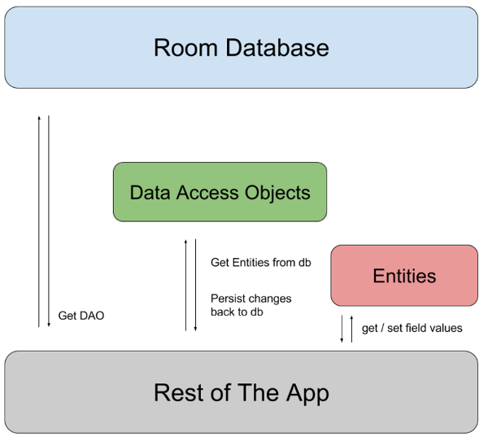
Room architecture
A DAO is a data access object associated with the database. Room database is used to get DAOs.
App then uses each DAO to get entities from the database and save changes to those entities back to the database
App uses entities to get and set values corresponding to table columns within the database
https://developer.android.com/training/data-storage/room

Slide 6
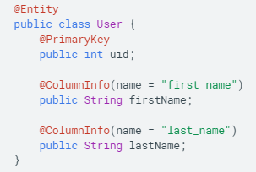
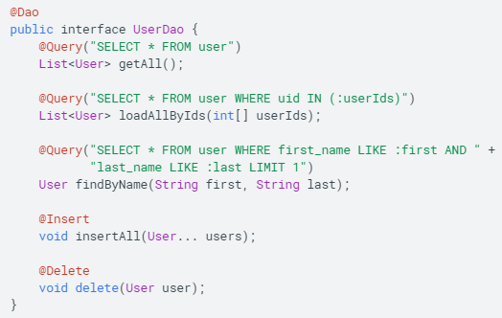


Example database configuration
user
UserDao
App database
Get an instance of created database
https://developer.android.com/training/data-storage/room

Slide 7
codelabs
https://codelabs.developers.google.com/codelabs/android-persistence/#0
https://codelabs.developers.google.com/codelabs/android-room-with-a-view-kotlin/#0

Slide 8
Define data using entities
Define relationships between objects
Create views into a database
Access data using DAOs
Migrate database
Test database
Reference complex data
https://developer.android.com/training/data-storage/room/defining-data

